Slide 1
TEL and the Common Core
How TEL resources can help you implement
Common Core Standards in your library.
Wendy Cornelisen
TEL Coordinator
Tennessee State Library

Slide 2
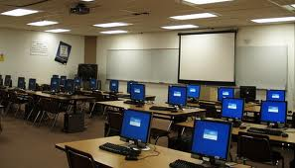
Overview
Common Core goals
Databases can provide Common Core resources
Search by Lexile score to find informational texts
Find professional resources to
share with other teachers
Notes:
Here are today’s training objectives…

Slide 3
The Situation
Only 21% of adults in TN have a college degree
TN ranks 46th in 4th grade math and 41st in 4th grade reading nationally
Tennessee’s
Competitiveness
54% of new jobs will require post-secondary education
Only 15% of Tennessee’s high school seniors are college ready
Sources: “Projections of Jobs and Education Requirements Through 2018” (The Georgetown University Center on Education and the Workforce),
2011 NCES NAEP data, ACT
Notes:
Common core was created by the council of chief state school officers and the national governors association. The goals…

Slide 4
Common Core Goals
www.corestandards.org
“To make sure that kids graduate high school with the knowledge and skills to succeed in college and, ultimately, to contribute to an increasingly competitive global workforce.”
“A clear set of expectations for elementary and high school students nationwide.”
Notes:
To create a clear set of expectations for elementary and high school students nationwide. Kids need to graduate with the skills to compete in the global workplace. Here’s a link to the Common Core standards page…

Slide 5
Not the goals:
Using the same books as everyone else
There are many paths to creating college- and career-ready graduates.
Making Lexile* the only important factor
It’s one of 3 factors: quality and task are also important.
Taking away all the fun books
Just because it’s not in the standards doesn’t mean reading for pleasure is forbidden.
Notes:
Common Core does not mean that we’re all using the same books. It’s impractical, and teachers need the flexibility to select the resources they need.

Slide 6
Tennessee’s Timeline
Notes:
Many schools in Tennessee are piloting the Common Core standards in ELA this school year.

Slide 7
Key Components
Literacy
Critical Thinking
Inquiry Process
Notes:
The Common Core hopes to cover several key skill areas. Literacy, Critical Thinking, and the Inquiry Process. These skills are very familiar to librarians. We call them 21st century skills or information literacy skills. This is what we do!
It doesn’t get librarians invited to the party—even though we know having a full-time, qualified school librarian is the best way to raise reading scores.

Slide 8
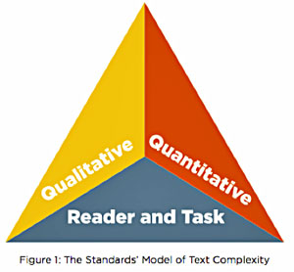
Complex Texts
Why is it complex?
Layout, structure, knowledge demand
How is it complex?
Lexile, word count, measureable
What does the reader have to know before-hand?
Notes:
There are now charts and graphs to help teachers figure out what they can use in their lesson plans. You’re still the best resource for finding this information.

Slide 9
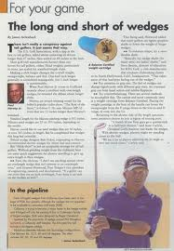
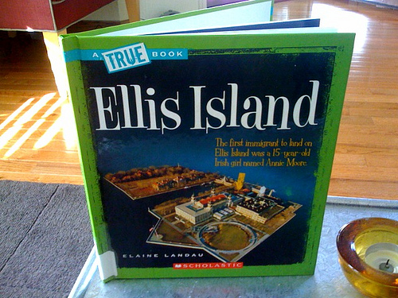
Informational vs. Non-Fiction
Non-fiction, based on facts
Informs the reader about the social or natural world
Does not include characters
Includes informational
Procedural: recipes, instructions
Narrative: tells a true story that reads like a novel

Slide 10
The shift begins

Slide 11
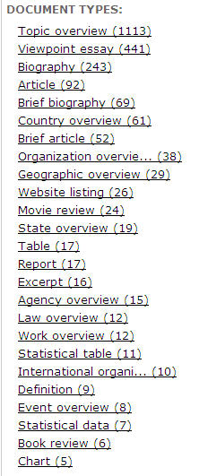
Multiple Viewpoints
Students will compare and contrast sources, assemble evidence, and make contentions of their own.
Cover Stories
Topic Overviews
Biographies
Editorials
Letters
Interviews
Article
Notes:
Point of View will be a large aspect of helping with the common core. Use the Document Type built into the databases to help figure out the point of view.

Slide 12
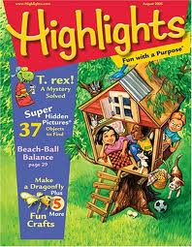
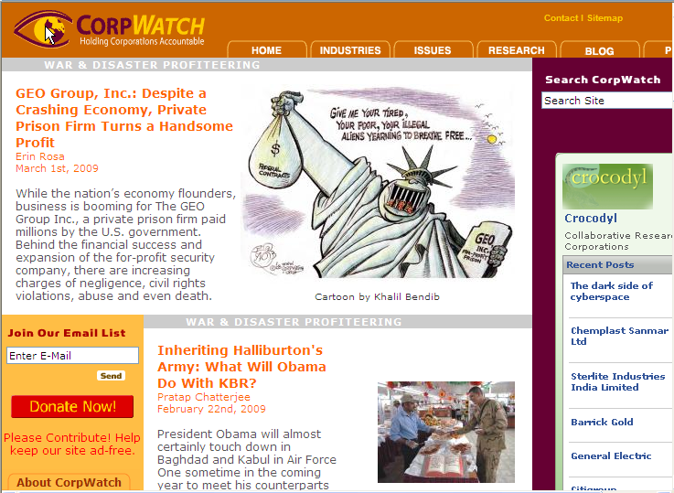
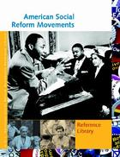
Sources for informational texts:
Videos
Academic Journals
Magazines
Newspapers
Reference Books
Websites
Notes:
Some of the best resources for multiple viewpoint, informational texts are not school textbooks, but reference books, magazines and newspaper articles.

Slide 13
Where can you find all these?

Slide 14
Elementary users
Kid Info Bits
Graphical kid-friendly interface
It’s easier for teachers to use PowerSearch to find articles by Lexile score
World Book
Most articles have a Lexile score.
Early World of Learning builds literacy
Learning Express Library
Math and Reading resources
Grades 4 and up

Slide 15
TEL4U.org

Slide 16
Middle and High School
World Book
Student
Discover
Advanced
Learning Express
Adds more subjects to each level
PSAT, ACT, SAT
New Gale resources
Student Resources in Context
Opposing Viewpoints in Context

Slide 17
Student Resources in Context

Slide 18
Opposing Viewpoints in Context

Slide 19
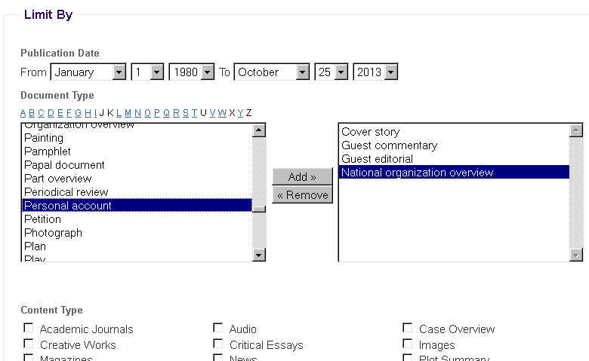
Advanced Search
Document type
Lexile score
Date
Content Type
Notes:
Advanced search is the same for both In Context resources.

Slide 20
Professional Development Resources
Research tools for educators
Search by Lexile score
Set up Journal Alerts
Create course packs
Save a list of articles, images, etc
Share with bookmark tool
Share resources with colleagues around the state

Slide 21
Create a Search Alert
Automatically re-do the search and send the new results via email
Stay up-to-date with topics for lesson plans
Find book reviews
Collaborate with colleagues anywhere in Tennessee

Slide 22
Advanced PowerSearch

Slide 23
Students Need:
contextual information to be able understand what they've read,
resources that provide background and overview information, and
multiple perspectives to help them learn to interpret what they're reading.
Notes:
The resources in TEL provide all of these things, for teachers and students, at no additional cost to your school.

Slide 24
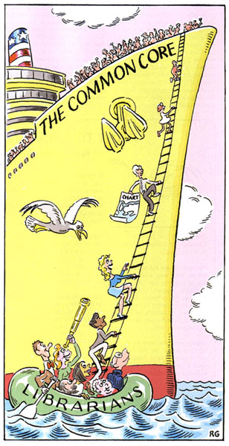
Questions?
wendy.cornelisen@tn.gov

